Slide 1


Container Tracking Demo
Paul Wenzel • Technical Sales Assistent • wenzel.paul@de.ibm.com

Slide 2
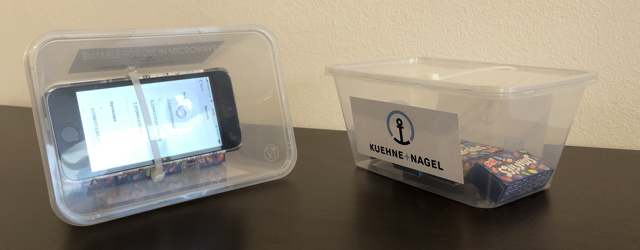
Container Model
iPhone attached to the box simulating the IoT device

Slide 3
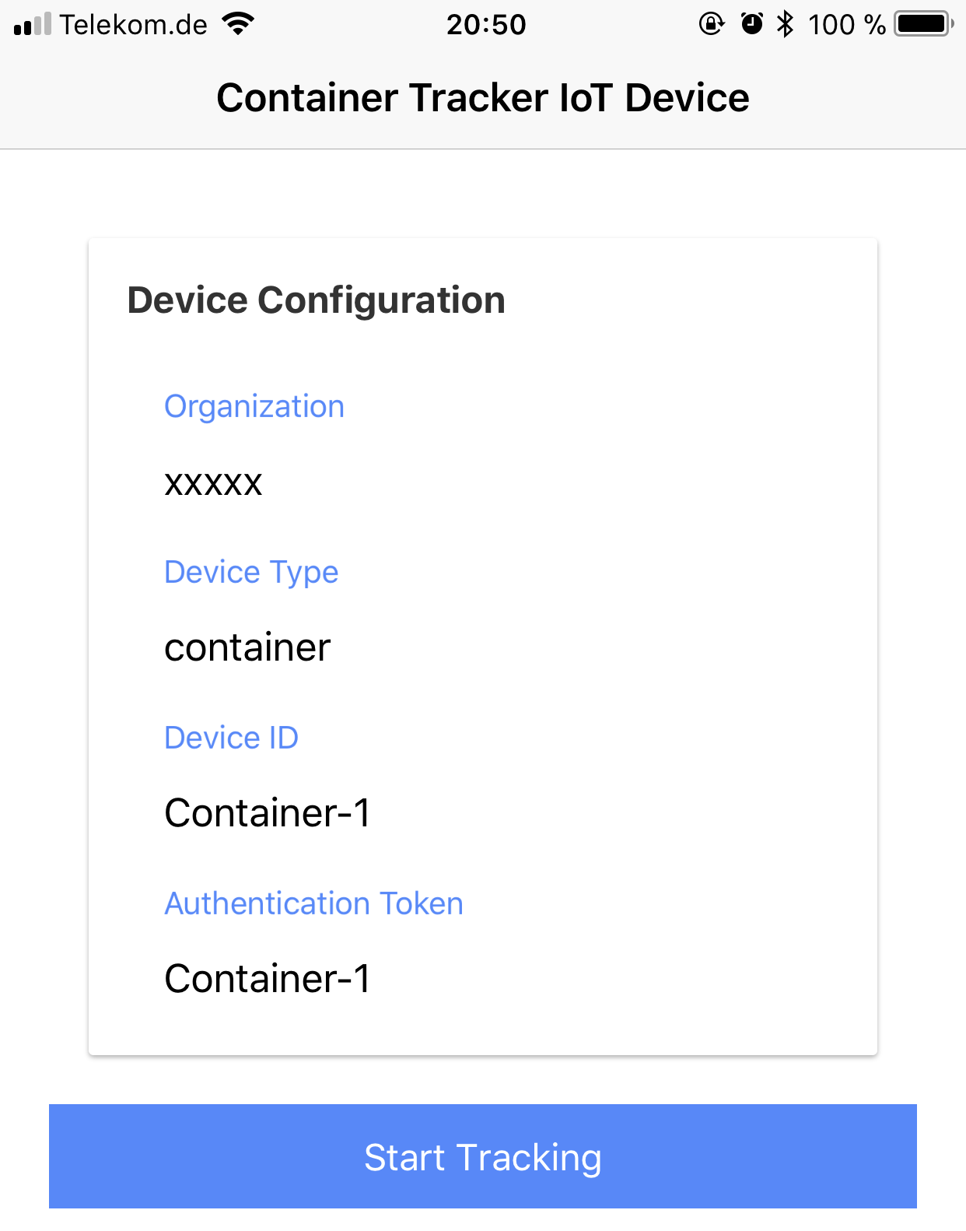
Ionic App – Home Page
the app runs on iOS and Android devices
the app simulates an IoT device
via the Home Page the connection of the IoT device to the IBM Watson IoT Platform can be configured

Slide 4
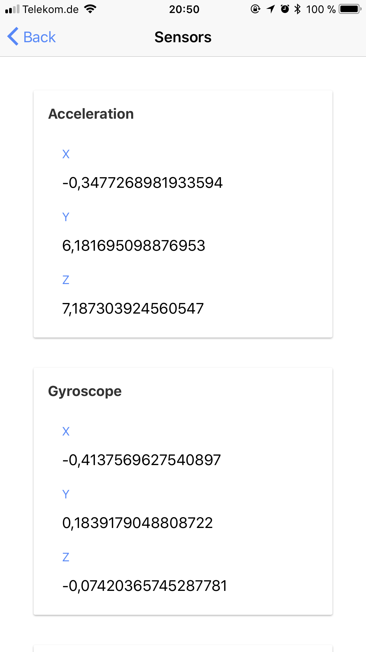
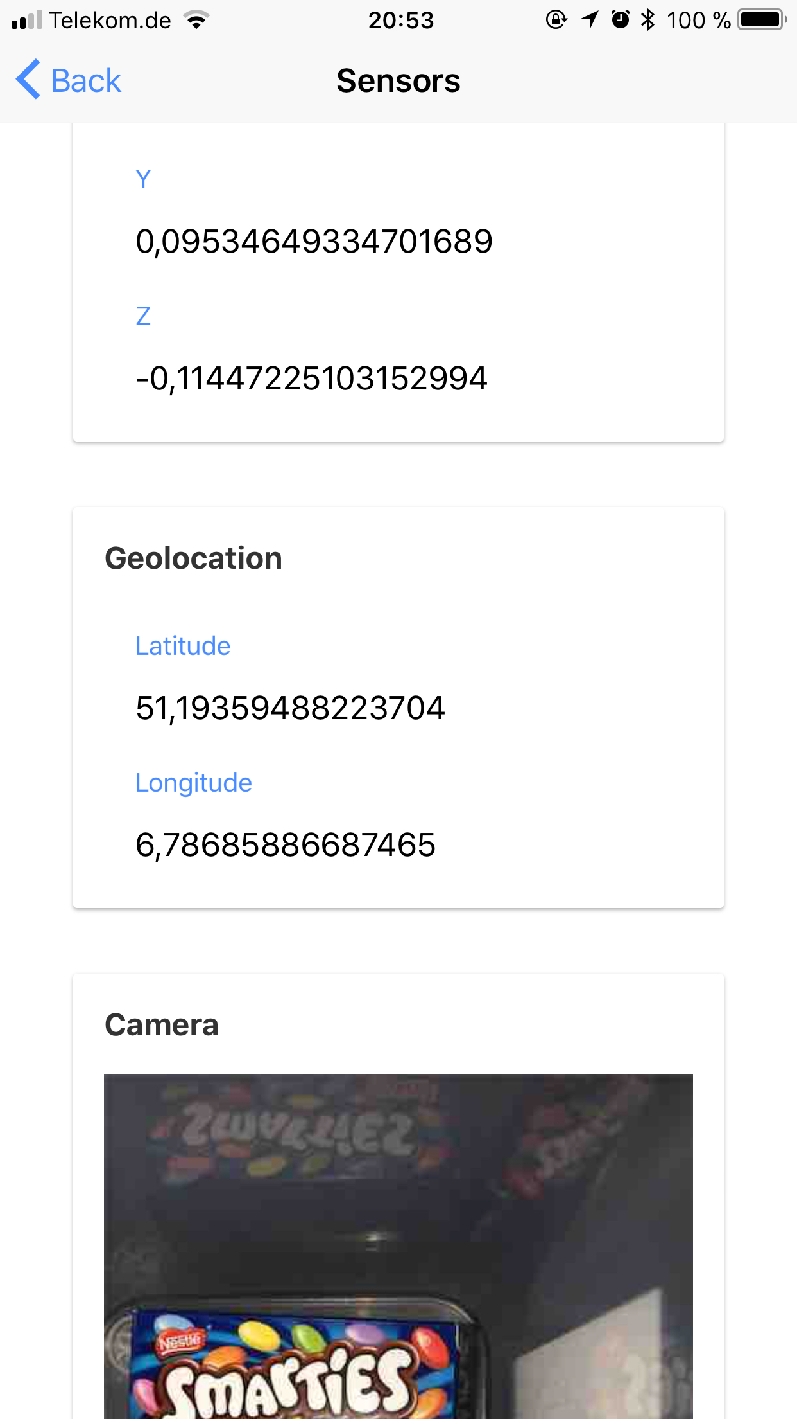
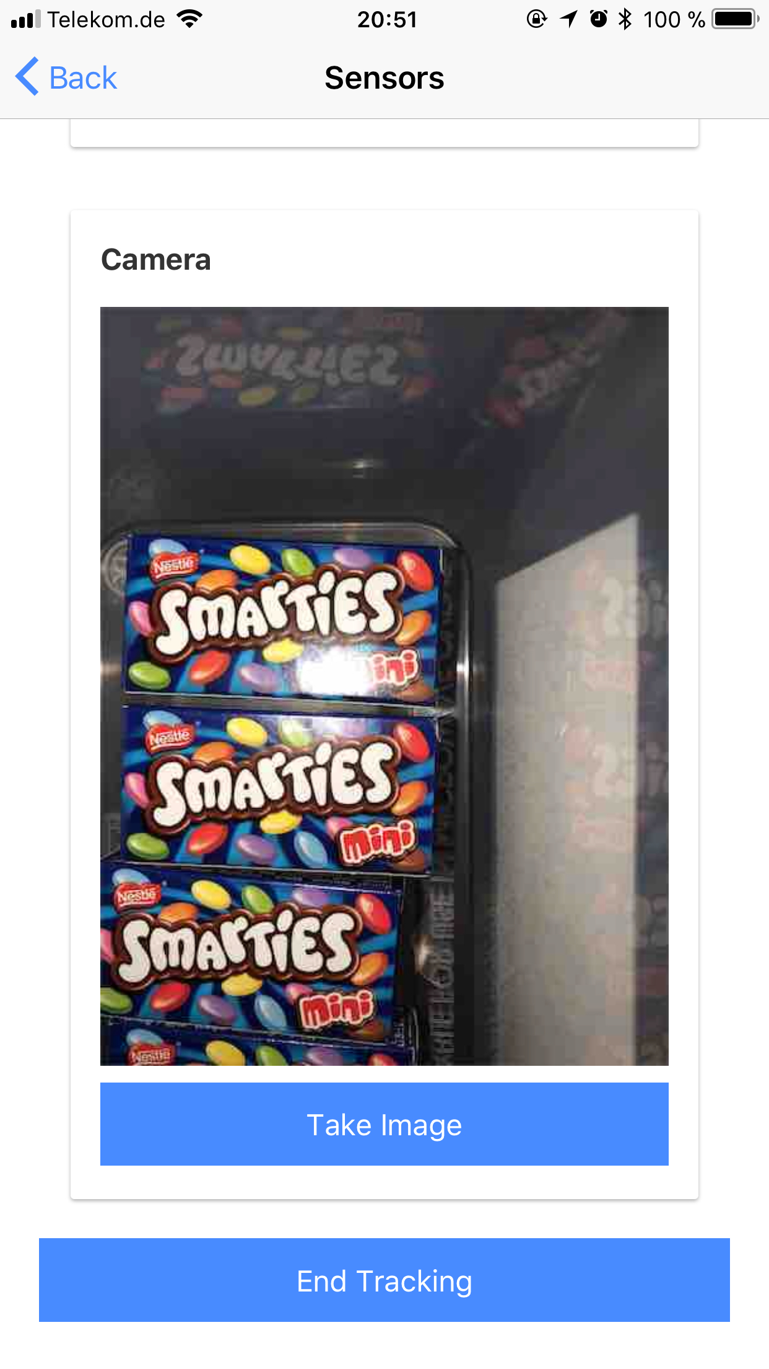
Ionic App – Sensor Page
collects the data from the device and sends it to the IBM Watson IoT Platform

Slide 5
Dashboard – Home Page
lists all devices
shows status of the devices
shows all exceptions collected by the devices

Slide 6
Dashboard – Device Page
acceleration and gyroscope sensor data represented in graphs
edge analytics simulation
select device to show
trigger device to take a picture
view last picture taken
map with all device locations
view device status
view exceptions recognized by the device

Slide 7
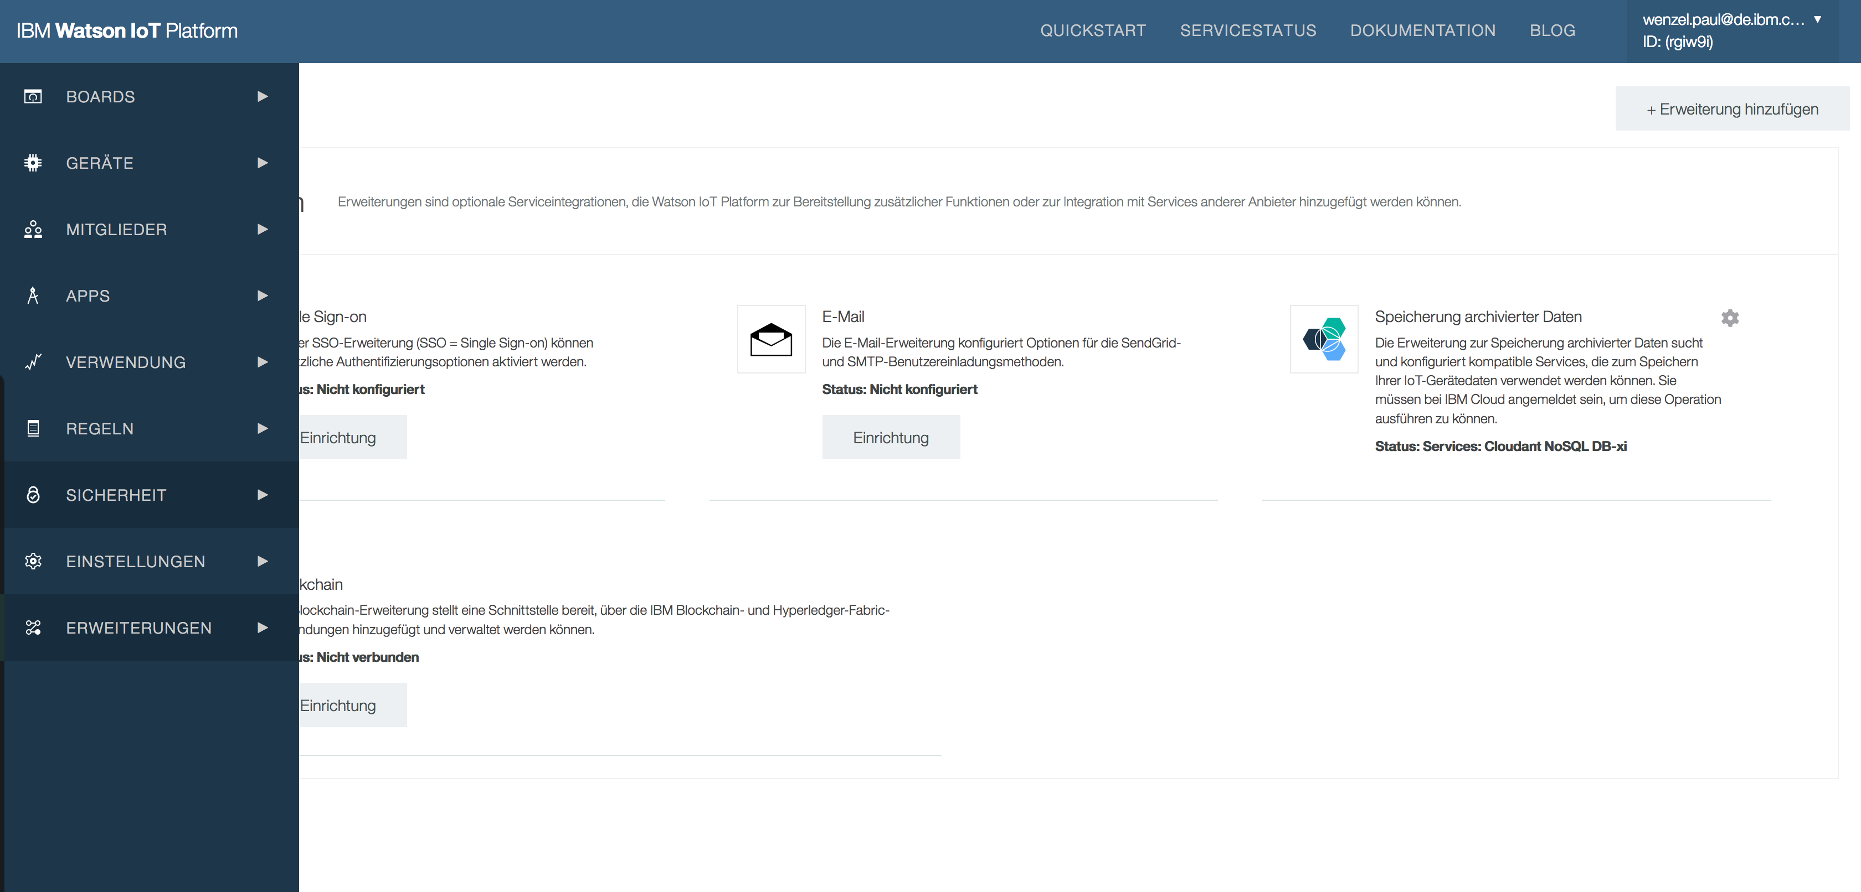
IBM Watson IoT Platform UI

Slide 8
NodeRED Flow of the Dashboard

